Slide 1
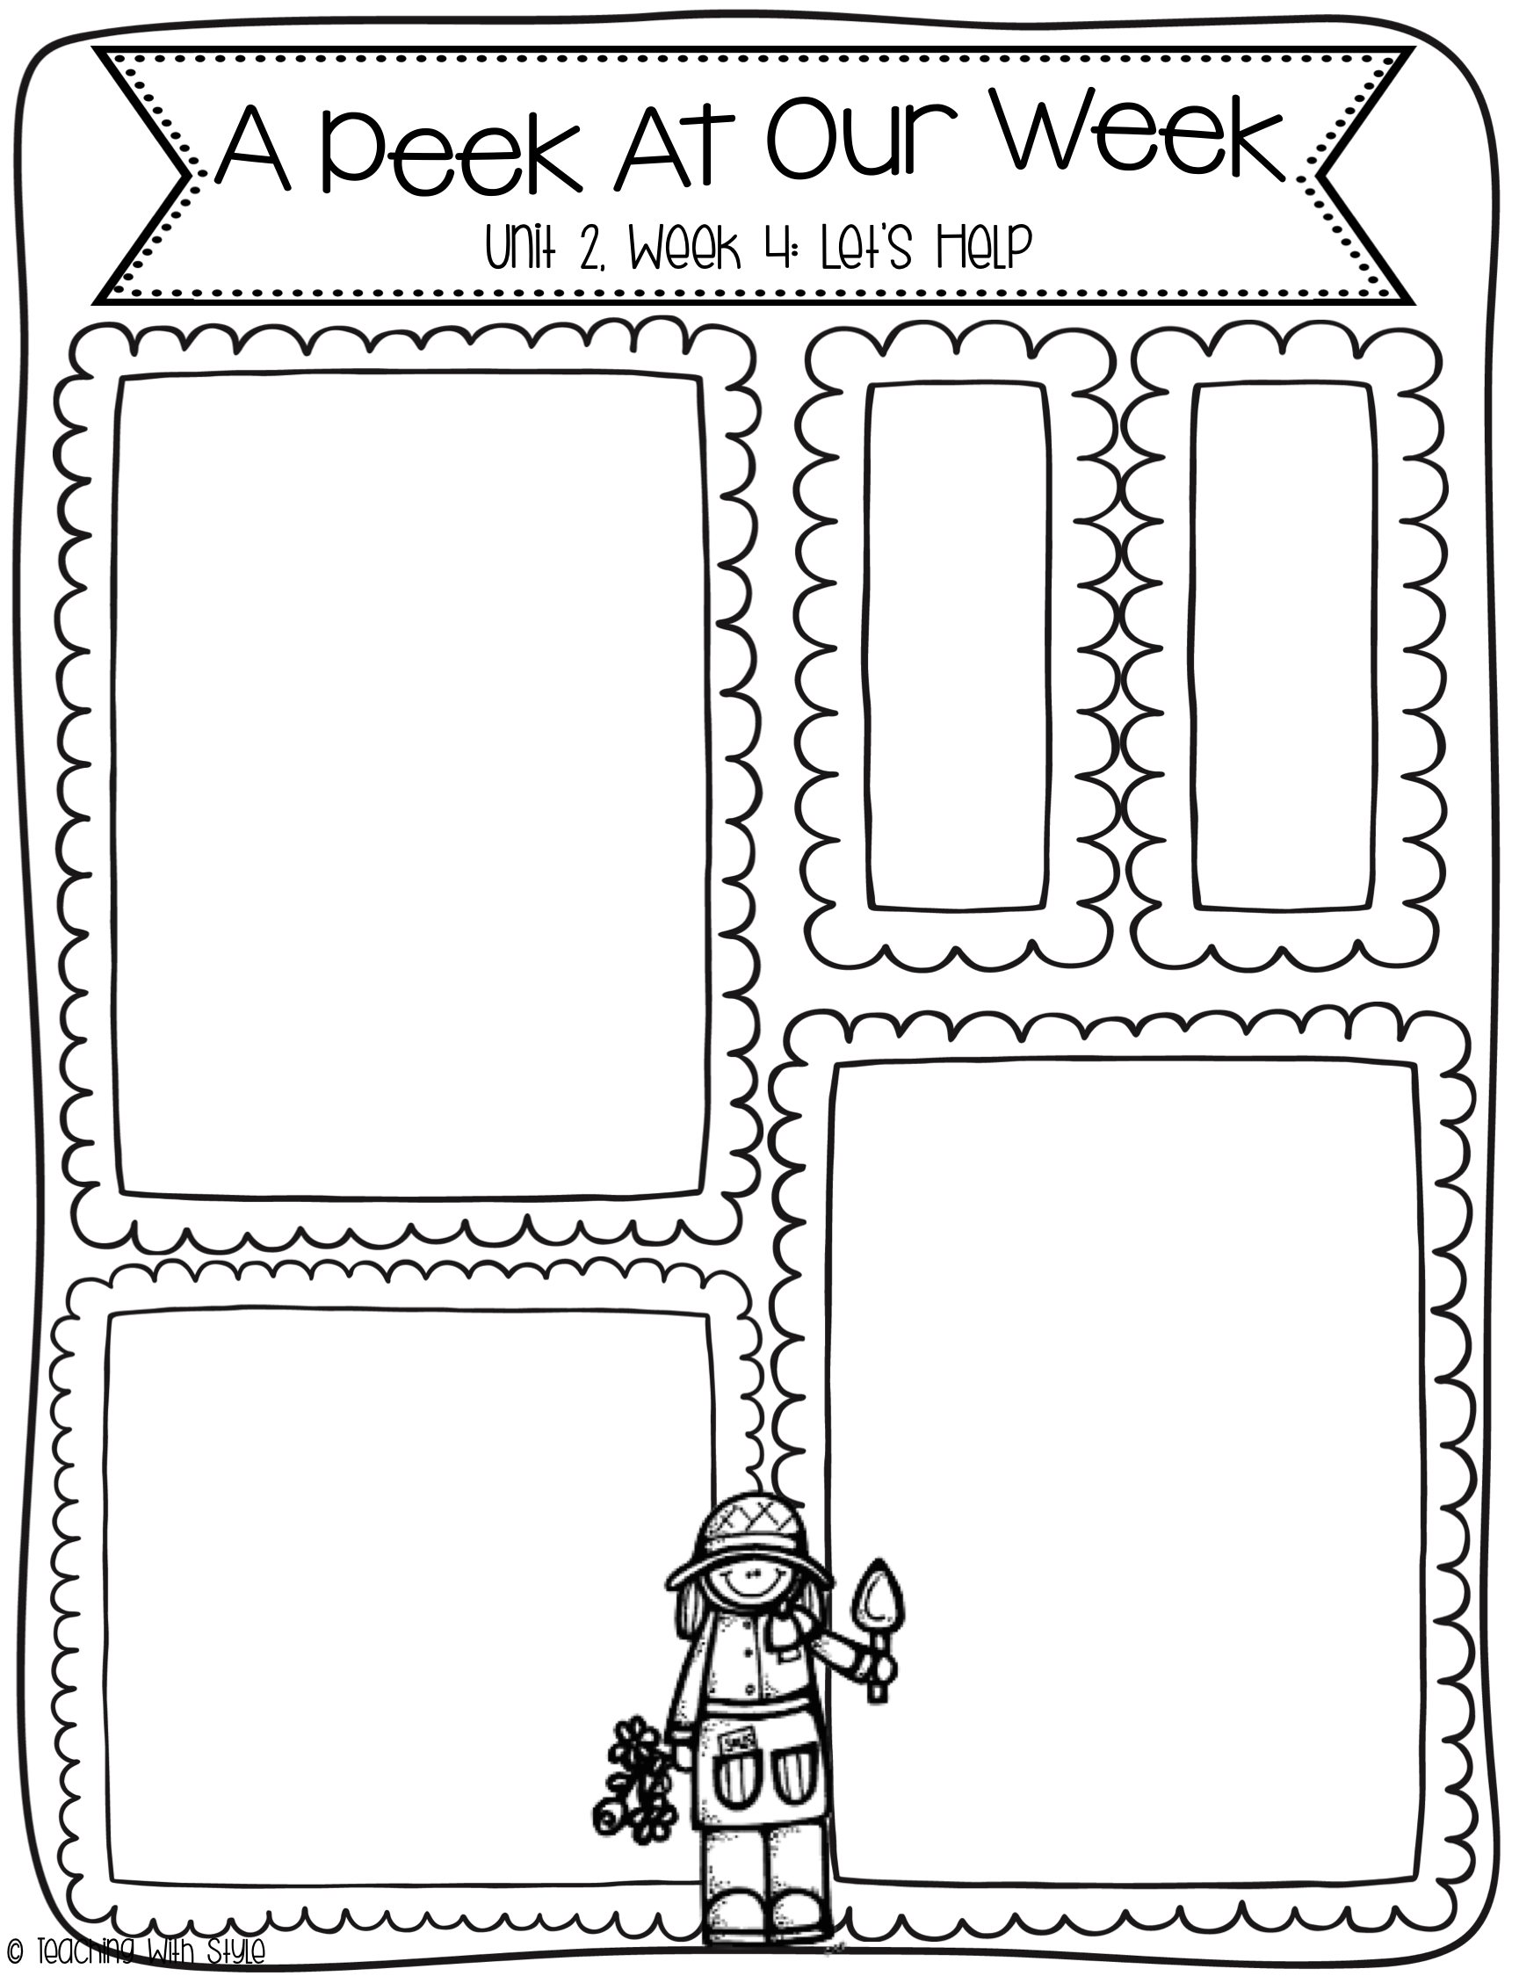
10/20-10/24
What we are learning!
Essential Question:
How do people help out in the community?
Comprehension Focus:
Character, Setting, Events
Word Work:
Consonant Digraphs
th, sh, -ng
Closed Syllables
Grammar:
Common and Proper Nouns
Writing Trait:
Organization
Spelling Words
fish
shop
ship
with
thing
sang
fast
wink
want
call
HF
Words
all
call
day
her
want
Vocabulary Words
leadership: the ability to guide a group of people, or the action of leading others
admire: when you approve of and like a person
connections: links between two or more things
enjoy: to like something
rely: when you know you can trust someone to help
Stories for the Week
Reading/Writing Workshop:
Thump Thump Helps Out
Genre: Fantasy Fiction
Literature Anthology:
Nell’s Books
Genre: Fantasy Fiction
Big Book: The Story of
Martin Luther King Jr.

